Slide 1
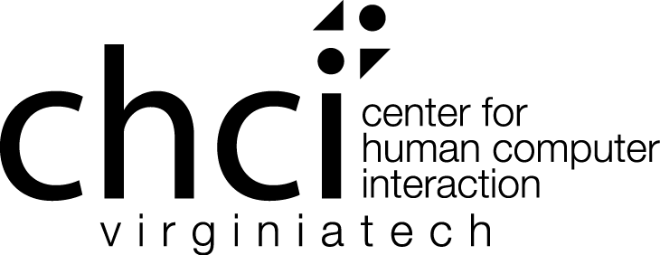
Collaborating with Claims in Interaction Design
D. Scott McCrickard
Center for Human-Computer Interaction
And Department of Computer Science
Virginia Tech

Slide 2
Capturing knowledge
Many domains involve specialized problems with overlap in technological need
potential for benefit from shared design knowledge
e.g., in-vehicle computing and support for cognitive disabilities, police patrols, emergency response, mobile health, construction
How should knowledge be structured?
visions: Nelson’s Xanadu, Bush’s Memex, Otlet’s Mundaneum
realities: papers, cases, scenarios, use cases, patterns, artifacts
possibilities: Youtube videos, blog posts, Google Docs, Twitter tweets
Approach: use claims as a design rationale (DR) knowledge-sharing unit in human-computer interaction (HCI) and usability engineering (UE) efforts
Notes:
realities vary
Toulmin
Rittel

Slide 3
Evolution of claims
Claims part of a common structure in rhetoric and argumentation (Toulmin, 1958)
Wicked problems and design rationale (Rittel & Webber, 1973)
IBIS, PHI, QOC, gIBIS, CodeBroker, Compendium (1970s-2010s)
Claims introduced as theory-practice bridge in HCI (Carroll & Kellogg, 1989)
often regarded as “designer digestible” “falsifiable hypotheses”
argued to be best suited to ephemeral, throw-away situations
evolved to include formal, structured uses (e.g., Sutcliffe, 1999; Chewar, 2004)
featured in a prominent HCI/UE textbook as part of a scenario-claims design approach (Rosson & Carroll, 2002)
my focus: claims as evolving, interconnected repositories used in the design process
Notes:
move away from the ephemeral “throw-away” nature of claims
focus on design, but don’t ignore science and engineering

Slide 4
Claims in HCI and UE
A claim is an expression of tradeoffs about an artifact in terms of effects on a user in a given usage scenario
the artifact describes some feature of an interface that has cognitive/psychological effects on a user
claims are generally grounded in the context of a real or constructed scenario or other story
a claim lists upsides/downsides (pros and cons) that reflect the tradeoffs the artifact causes in a user
Notes:
who does it: Carroll & Rosson, Wendy Kellogg, Alistair Sutcliffe, Steven Haynes
who teaches with it: one of the more popular HCI/UE books in the US

Slide 5
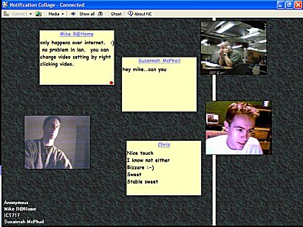
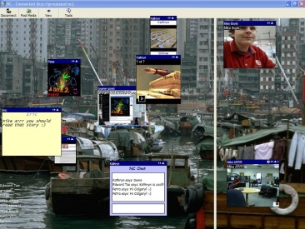
Claim example
Feature: Organizing information using a collage metaphor | + supports rapid identification of the newest items According to (Greenberg & Rounding 2001), “New collage items are always placed on top” suggesting users can quickly view new items and track relevance + links between cards can facilitate user interaction According to (Tomobe 2007), “users can discuss their activities on [a collage] intuitively” as seen in a workshop run by the author - BUT overlapping items create comprehension problems According to (Greenberg & Rounding 2001), “As the number of posted items increases, new elements cover old ones” suggesting difficulty in knowing about or finding older items

Slide 6
Hard problems for claims (and DR)
Creating [good, relevant] claims
→ start with a set identified by experts through lit review
Identifying claims relationships
→ observe connections and associations among claims
Making claims accessible
→ present claims in a way that a breadth of designers can use
Encouraging use of claims that lead to creating [good, relevant] claims
→ collect the rationale that is generated during design

Slide 7
Identifying claims relationships
Human categorization
e.g., The Design of Sites (van Duyne, Landay, Hong, 2007)
Critical parameters
e.g., the IRC model (McCrickard & Chewar, 2003)
interruption:� reallocation of attention from a primary task
reaction:� immediate response resulting from stimuli
comprehension:� information sensemaking and retention
analytic or empirical methods can position claims on a 0-1 scale
Social computing
e.g., claims relationships (Wahid & McCrickard, 2007)
fusion/diffusion: designer connection/separation of related ideas
mitigation: adding a feature to lessen a downside
activities of designers can connect paths of use for claims
Notes:
two of many methods; consider van Duyne, Landay & Hong’s “King of Patterns” approach that categorizes based on category (site genres, content management, e-commerce, navigation)

Slide 8
Leveraging the masses
Collaborative views like “Recent” and “Top 10% & 20%” affect use and decision-making
Lighted directional path card was created
Elevated to green status as more and more people found it in the recent view
“I used the most frequently used cards as a starting point for my exploration of options in the ideation stage.”
“Yeah, I don’t even like allowing [previous use] to influence…I mean honestly I could even imagine myself being biased in the other direction.”
“because it is a storyboard, it necessitates thinking about workflow which is something that can get lost a lot…especially with somebody who isn’t thinking about design all the time.”

Slide 9
Making claims accessible
Claims capture and connect design knowledge
BUT there are still barriers to claims being used
particularly for large libraries of claims
easy to search, but hard to browse
Solution: leverage images as part of visual design
accessible to designers (e.g., technologists, UI experts) as well as domain experts (e.g., police officers, emergency personnel)
encourages communication among members of a design team
“intentional deception” can initiate creative ideas
access to DR encourages thoughtful reflection

Slide 10
Leveraging images
Images and imagery
images of existing interface claims triggers imagination, inspiration
imagery refers to both sets of images and their contextual interpretations
targeted for novices (in design or in domain) to understand domain
Design rationale as images
exploration into the knowledge about design, such as reasoning, to help the process
generally requires time, effort, learning curve
images help reduce learning costs
A sliding effect used to transition within and between notifications
+ can reliably divert the attention of the user to essential information
+ increases user knowledge of information with regular usage
- causes 40% degradation in primary task performance time

Slide 11
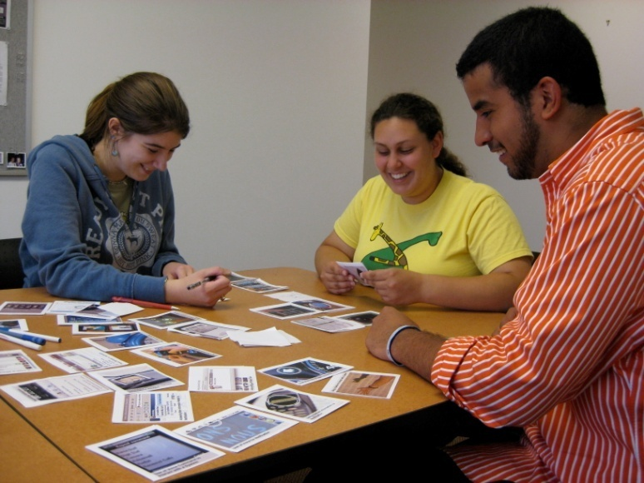

Slide 12
Capturing Design Decisions with PIC-UP
Wahid, Branham, Cairco, McCrickard, Harrison 2009
Notes:
PIC-UP (the desktop/tablet app) available at milkbottle.cs.vt.edu
PIC-UP Brain (the Android app) available on the Google Marketplace for mobile apps

Slide 13
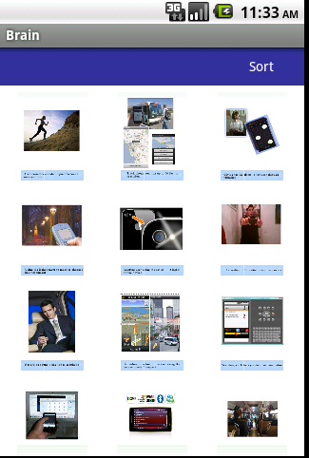
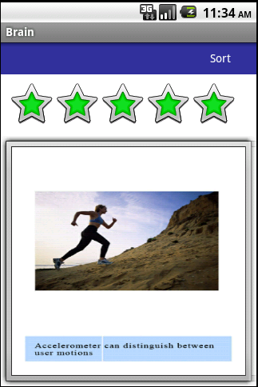

Slide 14
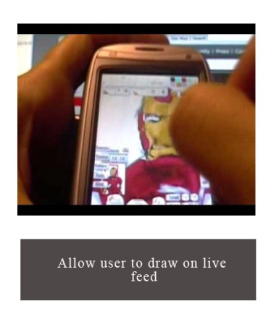
The role of technology in design
Free-form formats support designerly processes
But technology allows us to capture design rationale for reflection, review, catch-up, search, …
Seeking middle ground

Slide 15
Ongoing and future efforts
Making claims more accessible
creating claims for key design areas (mobile, notification)
identifying quality claims at an appropriate level of generality
using claims sets in classes, design meetings, etc.
Identifying relationship models for claims
based on content and community
Automatic extraction of claims from databases
databases can include papers, chat/meeting logs, blogs, case studies, scenario/case libraries
Applying approaches to other knowledge repositories

Slide 16
Thanks!
Shahtab Wahid
Ph.D. at Virginia Tech (2011); now at Bloomberg
Christa Chewar
Ph.D. at VT (2005); now at the United States Military Academy
Jan-Willem Streefkerk
TU Delft/TNO
other collaborators Steve Harrison, Jason Chong Lee, Jacob Somervell, John M. Carroll, Alistair Sutcliffe, Ali Ndiwalana, and others
funding from the NSF (ITR, REU, CRI, EAGER), DoD, Google, Meridium

Slide 17
Questions/Comments
Scott McCrickard
mccricks@cs.vt.edu
people.cs.vt.edu/~mccricks/
mccricks.wordpress.com
?

